Slide 1

Employment First
Employment Now
Where is Hawai’i?

Slide 2
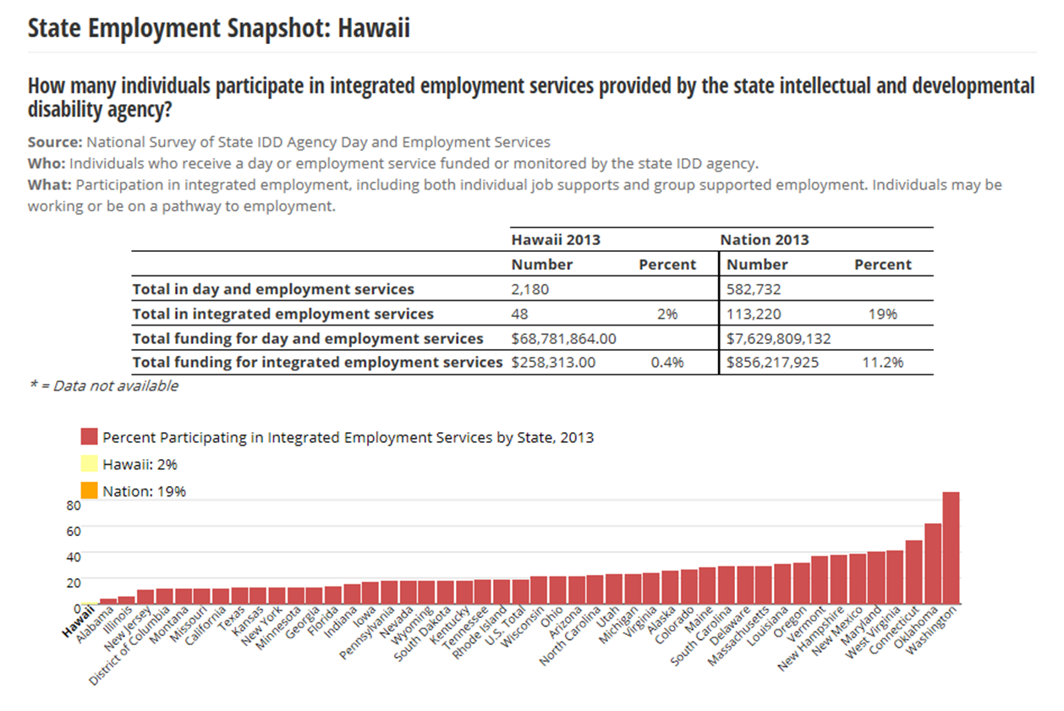

Slide 3
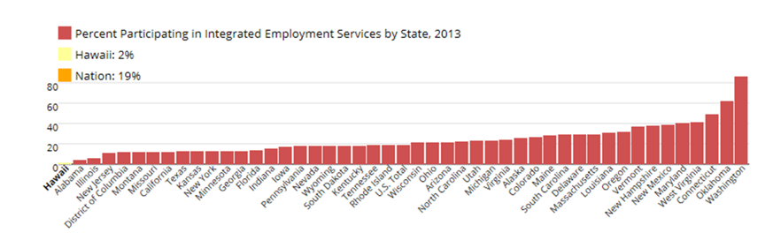
Hawai’i can do better!

Slide 4
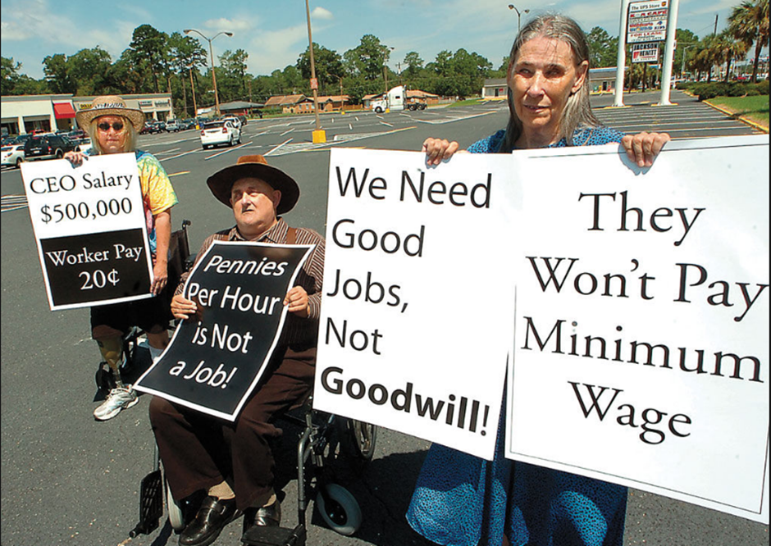
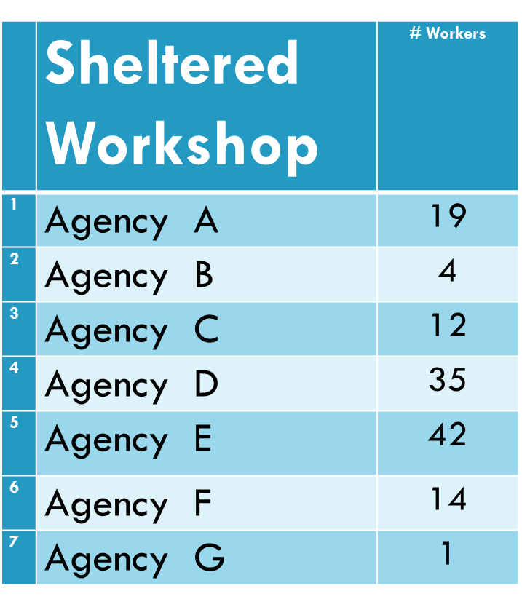

Slide 5
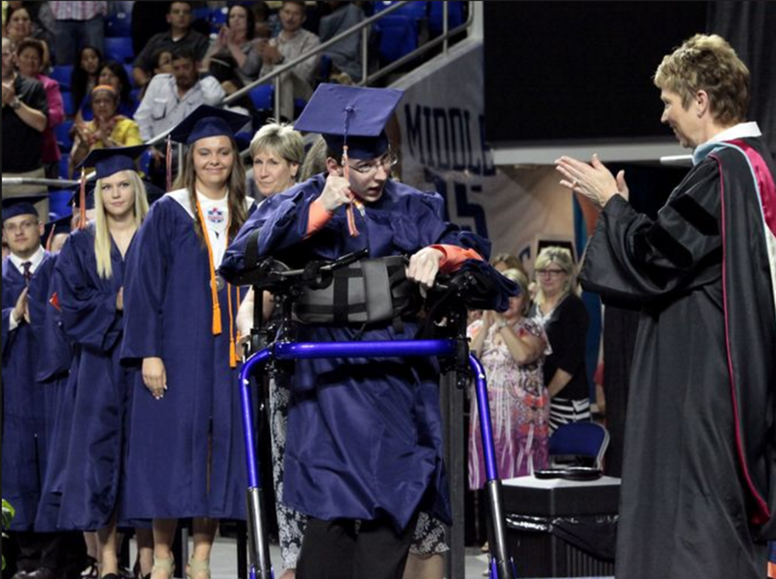
What happens after this great moment?

Slide 6

What’s the problem?
Soft Skills
Social Connections and help to locate openings
Transportation Access
Resume that puts job seeker in a positive role
Training and Documentation
On The Job Training and Support
Work Experience

Slide 7

Employment helps people:
Improve their reputation in the community
Benefits their physical health
Decreases their dependence on paid staff
Provides an opportunity to make friends
Increases socio-economic status

Slide 8
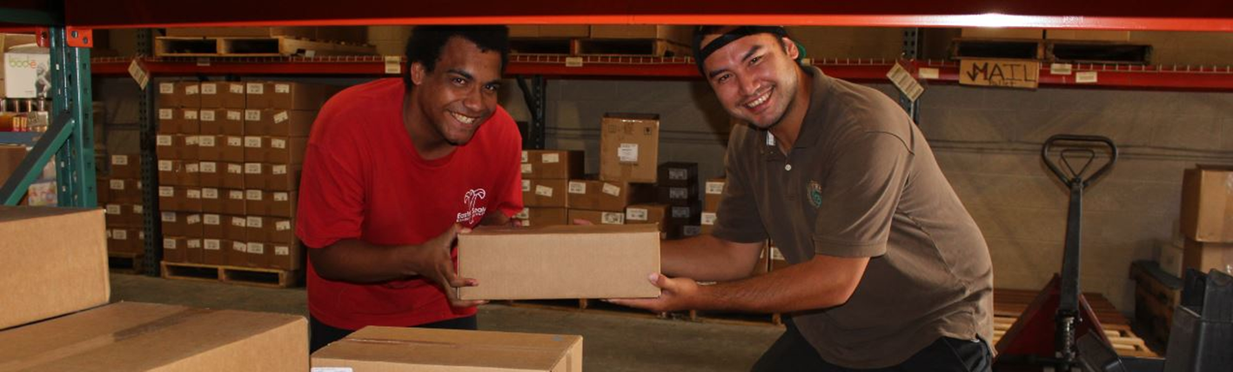
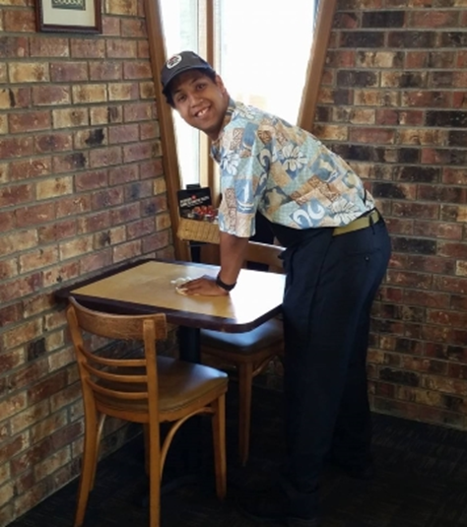
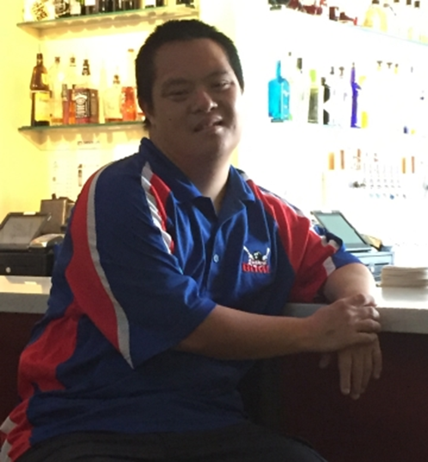
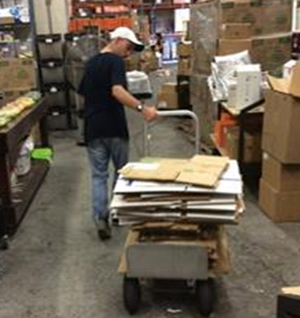
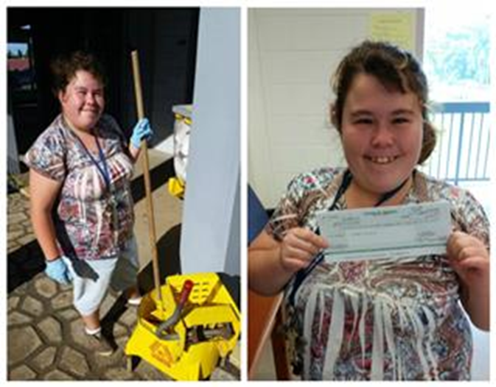

Slide 9
Currently Hawaii has the lowest national employment rate for adults with an intellectual or developmental disability and provides support to 127 adults who are currently employed in sub minimum wage jobs.
The challenge is to redesign the employment experience for individuals with an intellectual or developmental disability in Hawaii in a way that might:
Encourage and track skill acquisition
Create a video resume (puts job seeker in positive role)
Connect the job seeker with their employment team
Connect the job seeker with transportation options
Encourage social connections and provide Q and A for team members
Locate businesses who have a need that matches the job seekers skills

